Slide 1
CS568 Foundation of Cloud IOT Edge ML
Prof Rajiv Misra
CSE

Slide 2
Lecture Schedule
Theory Classes (2) Wed 2-3, Fri 2-3 ( R-408)
Lab Classes(2 hour) Thursday 9-11AM ( CSE)
Evaluation (100)
Mid Sem(2hr) : 25
End Sem(3hr) : 35
Practical(2hr weekly evaluation):40

Slide 3
Syllabus
Module1: Cloud Overview. Internet of Things and the Cloud IoT Edge
Introduction to Cloud, Internet of Things (IoT), and Edge Computing Paradigms.
Public Cloud based IoT model: Sensors, Cloud IoT Edge roles, Cloud Intelligent Edge and IoT Hub, u-services model, data center file system and database infrastructures, big-data analytics infrastructures.
Case study: Prominent Cloud Provider’s IOT Model
Module2: IoT sensor registration. Risk of sensor inaccuracy
The Cloud based IoT solutions and the concept of a secure sensor with a managed life-cycle. Sensor properties. Fault-tolerance. The model of fault-tolerance for IoT devices. Cloud IOT Application Programming.
Module 3: Pool model for Microservices
Introduction to containers, Docker, container images, container orchestration.
Introduction to Kubernetes architecture, Kubernetes objects kubectl command
Virtualization using a hypervisor such as Xen versus container virtualization using Kubernetes with help from an OS like Mesos. Managed microservices, elastic pools, stateless programming.

Slide 4
Module 4: Time and Causality - Actual Clocks, Logical Clocks, Timestamped IoT Data
Timestamped data. Clocks and clock synchronization. Causal ordering and causal clocks. Snapshots and consistent cuts. Indexing into DHT data. Temporal computing,
Module 5: Integrating Machine Learning and Analytics at the IOT-Edge
Integrate machine learning and analytics into Edge Computing to perform decision-making, self-healing, and self-learning, using Tensorflow on Raspberry Pi.
Introduction to Machine Learning Services at Public Cloud Use Cases for Edge Machine Learning and Deep Learning: Real-time Stream Analytics, Applications for Drone, Immersive Technologies AR/VR, Self-driving cars etc
*Laboratory assignments will be based on theory classes.

Slide 5
Learning Objectives
The primary objective of this course is to introduce the processing of IoT data with machine learning, specifically on the edge.
While we touch many aspects of a general machine learning workflow, concepts of time and ordering in distributed system and cloud native computing.
How IoT applications can take advantage of the intelligent cloud and the intelligent edge using the concepts of training a machine learning model with data collected from IoT devices in the cloud, deploying that model to IoT Edge, and maintaining and refining the model periodically.

Slide 6
Course Description
The internet of things (IoT), cloud computing, machine learning, and fog computing challenged traditional computing models, resulting in convergence in emergent computing paradigms known as Edge Computing.
Distributed Computing has taken shapes from cloud to edge.
This course was created with the goal of providing a thorough grasp of the convergence of technologies (IoT, ML, and Cloud) for various new computing paradigms of Edge Computing using popular services such as Microsoft Azure IOT Hub and Amazon Web Services IOT Greengrass.
The key principles, combined with laboratory practice, provide a thorough understanding of "Intelligence at the IoT Edge," which underpins Cloud-IoT-Edge challenges, applications, systems, and methodologies that underpin Emerging Internet of Things (IoT) with Edge computing applications such as augmented reality, self-driving cars, and others that are time-sensitive and computation-intensive, requiring real-time processing of vast amounts of data generated by widely dispersed en masse sensors.

Slide 7
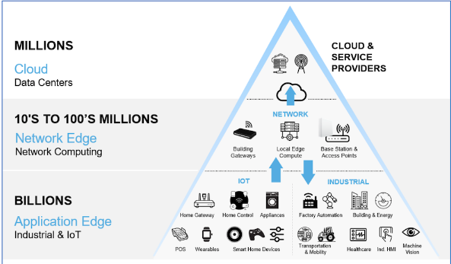

Slide 8
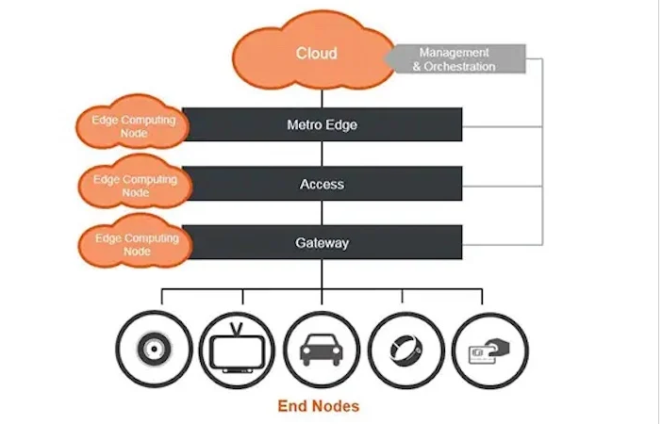

Slide 9
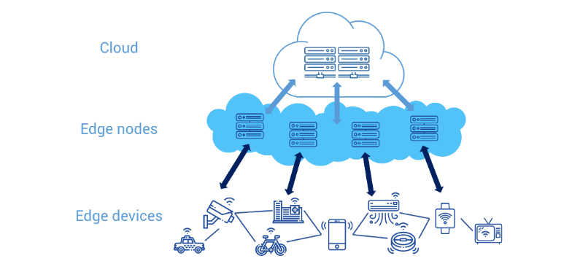
Edge Computing
Edge computing is a distributed computing concept that integrates intelligence to edge devices, also called edge nodes, allowing data to be processed and analyzed in real time near the data accumulation source.
In edge computing, data does not need to be uploaded directly to the cloud or to a centralized data processing system.

Slide 10
Why Use Edge Computing?
Most companies store, manage, and analyze data on a centralized storage, typically in a public cloud or private cloud environment. However, traditional infrastructure and cloud computing are no longer able to meet the requirements for many real life applications. For example, in the case of IoT (Internet of Things) and IoE (Internet of Everything), a highly available network with minimal latency is required to process large amounts of data in real time, which is not possible on a traditional IT infrastructure. In this case, the advantages of edge computing becomes more obvious.
Advantages of Edge Computing
In edge computing, data is processed close to the data accumulation source, so there is no longer the need to transfer data to the cloud or to an on-premises data center for processing and analysis. This approach will lessen the load on both network and servers.
Owing to its ability to process data in real time and its faster response time, edge computing is highly applicable in the field of IoT, particularly industrial IoT (IIoT).
In addition to accelerating digital transformation for industrial and manufacturing enterprises, edge computing technology allows for more innovations including artificial intelligence and machine learning.

Slide 11
Difference between Edge Computing and Cloud Computing
The main difference between cloud computing and edge computing is where the data is being processed.
In cloud computing, data is collected, processed, and analyzed at a centralized location.
On the other hand, edge computing is based on a distributed computing environment, in which data is collected, processed, and analyzed locally.
There is no need to choose between cloud computing and edge computing for cloud solution, they don't "compete" with each other, they just complement each other and work together to provide a better performance on applications.
Alibaba Cloud IoT platform provides edge computing and other capacities to empower various IoT scenarios and industry developers.

